Slide 1


DEPARTMENT OF ELECTRICAL AND ELECTRONICS ENGINEERING BIRLA INSTITUTE OF TECHNOLOGY, MESRA
CLOUD-BASED DATA PROCESSING AND VISUALIZATION OF SENSOR DATA TAKEN FROM A POWER SYSTEM (Micro-Grid)
SUPERVISED BY:
DR. AFTAB ALAM
PRESENTED BY :
ABHINAV ANAND (BE/10244/16)
ANUJ KAPOOR (BE/10506/16)

Slide 2
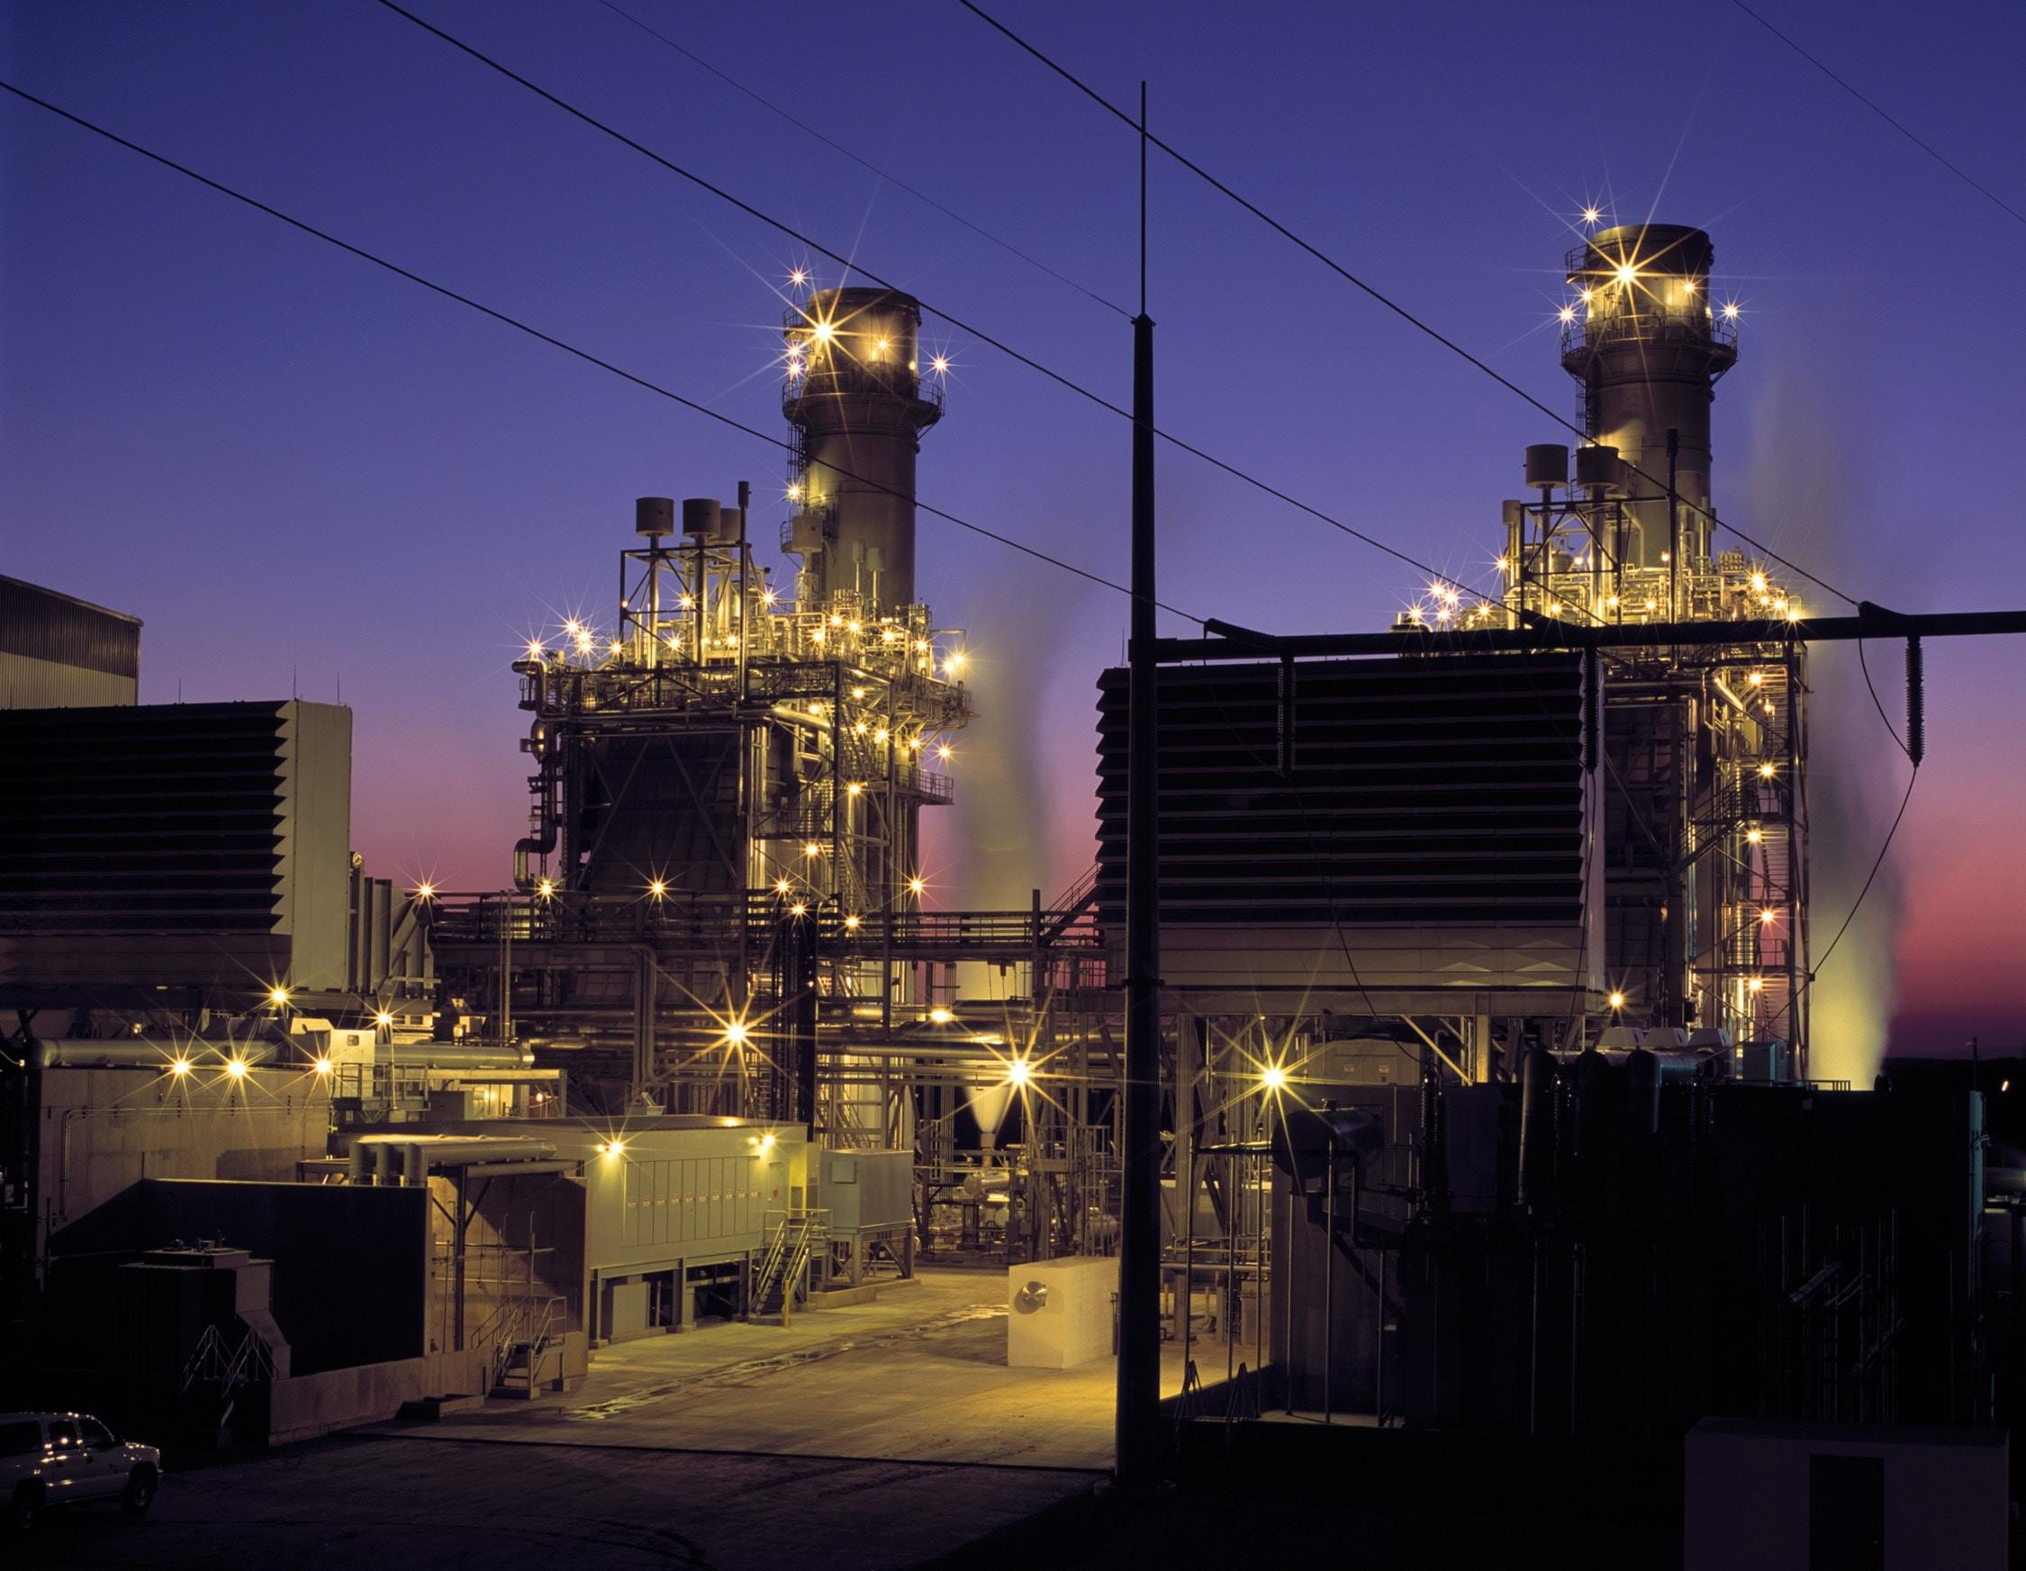
OBJECTIVE
1
Acquiring multiple sensor data on a Raspberry Pi/ NodeMCU using multi-channel ADC for transfer to cloud based server.
Creation of cloud-based processing infrastructure for sensor data processing to run algorithms which allow health monitoring and optimum control of a power system.
2
Development of a portal for visualization of the parameters of the power system and the processed data and also allow for storage of the same in a database.
3

Slide 3

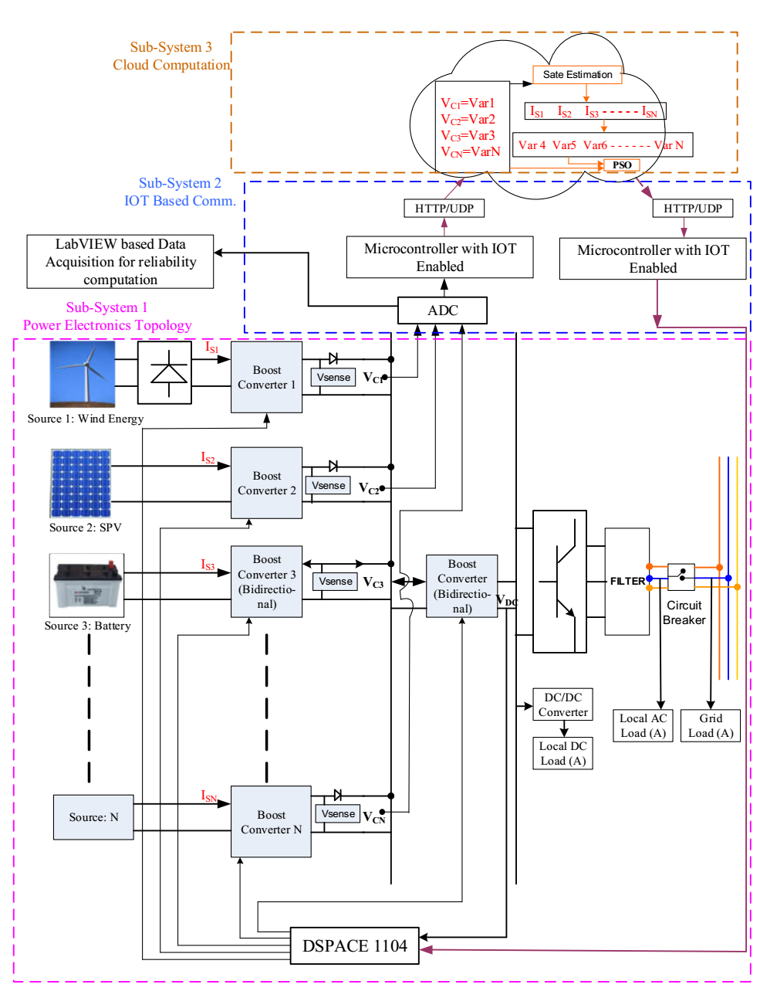
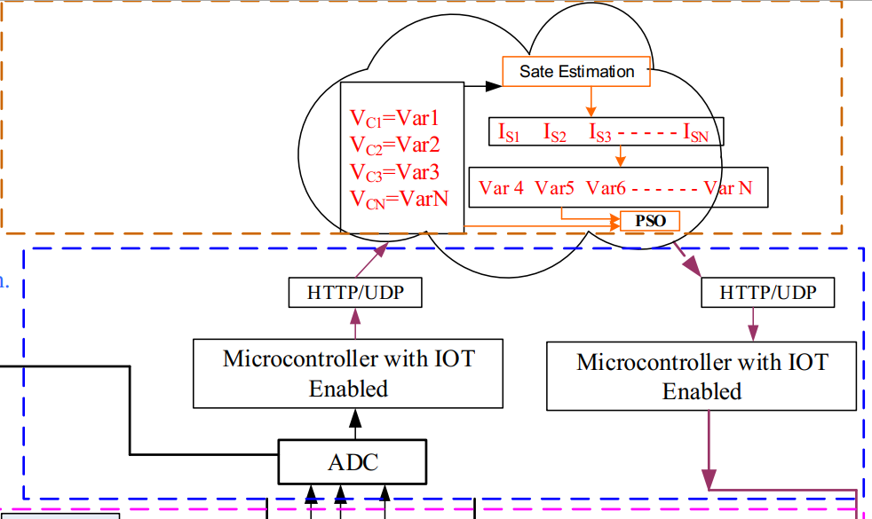
MICRO-GRID

Slide 4

WHAT OUR PROJECT OFFERS TO THE CONSUMER/INDUSTRY
Warning system for all the subsystems inside the Micro-Grid.
Monitoring of Injected/Withdrawn power by the Micro-Grid from the supply grid which helps us find the profitability and calculate incentives.
The recorded data can be used to calculate the user behaviour and efficiency of the system.
The data is also beneficial to the maintenance engineer as they can localise the fault quicker. Neural Network can be used for fault prediction based on historical fault data.
More security for database and administrators as there is no local server and the cloud server employs state-of-art security measure

Slide 5

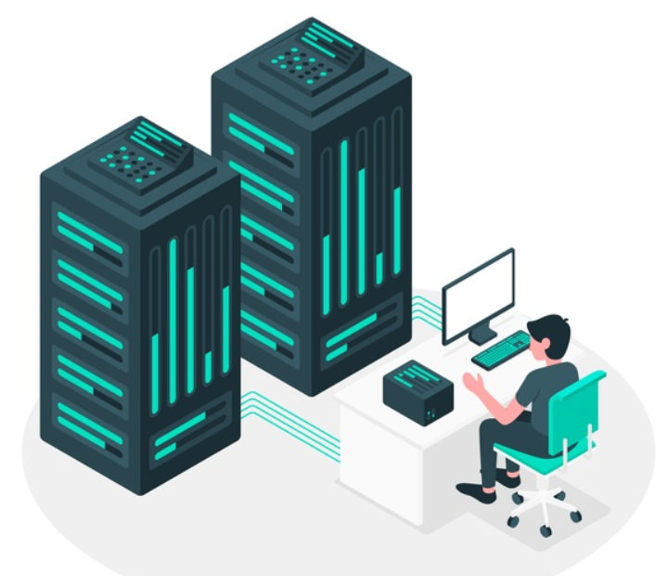


HOW OUR PROJECT IS RELEVANT IN THE CURRENT SCENARIO
Remote planning
And Decision-making
Technical advancements and increased security
COVID-19
Reduced Cost due to
more usage
Easy to use without extensive training

Slide 6
INTRODUCTION
Sensor Data acquisition from multiple sensors in a Micro-grid.
Optimally quantifying sensor data for fast transfer to cloud.
Use of State estimation for current sensor reduction.
Use of objective function and PSO to maximize power intake from renewable sources and calculation of injected/absorbed power of the micro grid.
Data processing on cloud to create visual insights.
Benefits of cloud server are high processing power, scalability, customizability.

Slide 7
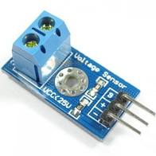
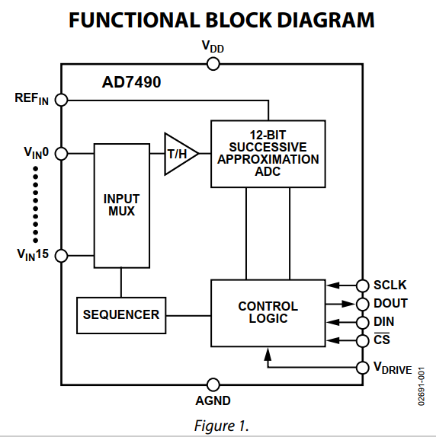

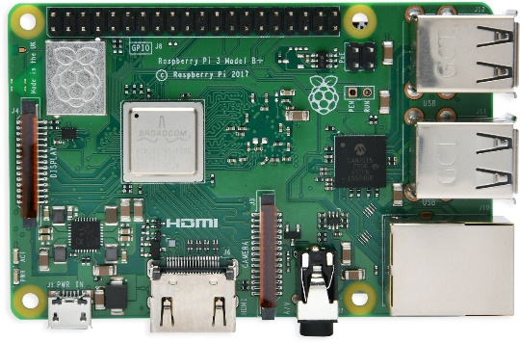
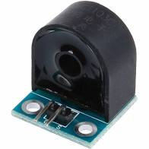

METHODOLOGY
Sensors connected to the power system
Python code to acquire sensor data from ADC into RAM of Raspberry Pi
Data is sent to Cloud platform using API protocol
Voltage sensors
Raspberry Pi is connected to internet using router logged into college network using designated high-bandwidth account
16 Channel 12 bit ADC (4 IC’s per Raspberry Pi)
AD7490BRUZ
1 ms throughput rate
Current sensors

Slide 8
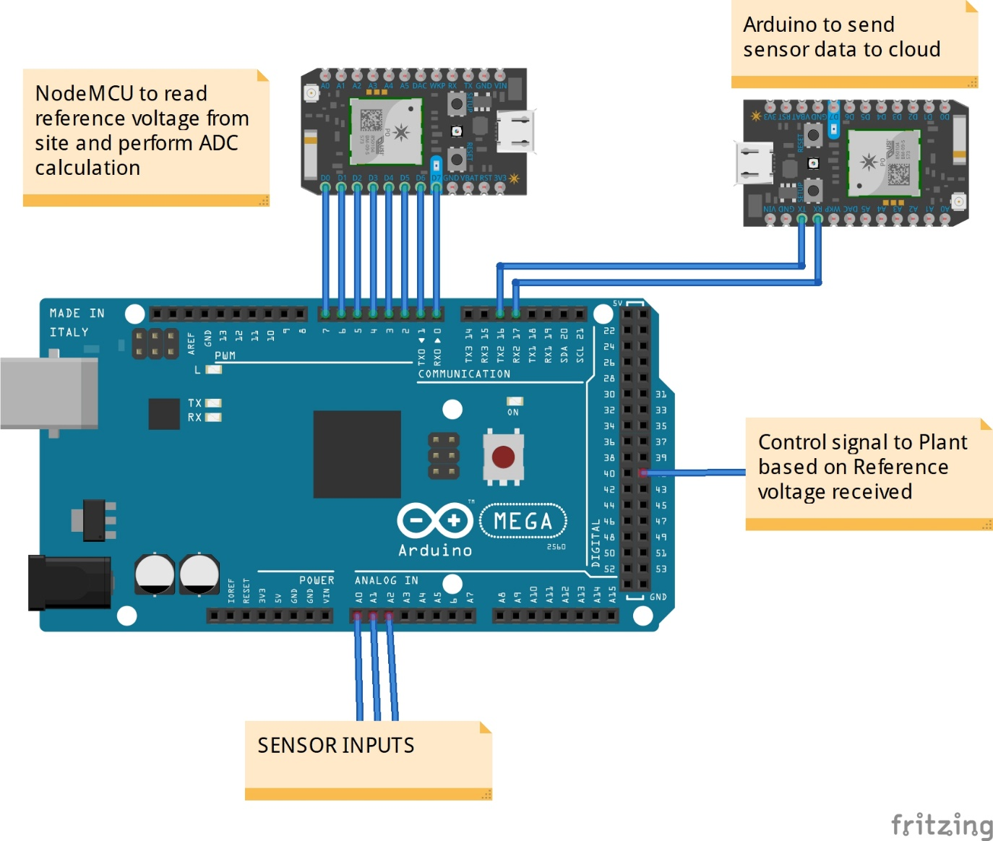
SETUP FOR INTERNET OF THINGS

Slide 9
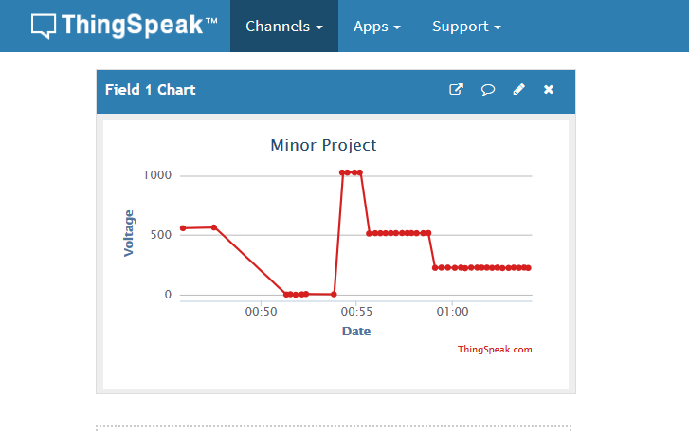
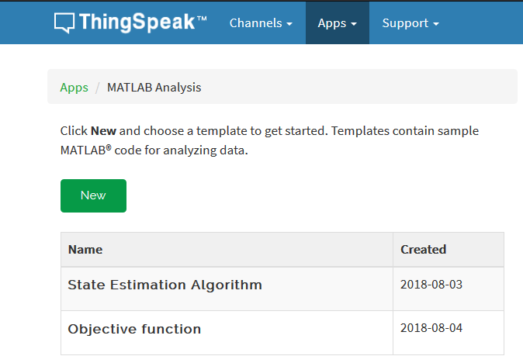
PRE-BUILT INFRASTRUCTURE
Infrastructure Created
(Thingspeak, delay of 15 seconds, MATLAB analysis available)

Slide 10
DISADVANTAGES OF PRE BUILT ARCHITECTURE
Using a pre built infrastructure like “Thingspeak” comes with its own drawbacks :
15 seconds delay for each API call.
Non-Scalability of the platform for large number of sensors.
Only a single channel API can be called at once
No Scope for setting up a data-pipeline for storing of data.
Lack of tools for complex MATLAB Computing.
As it is a pre built utility, It always comes with a high cost.

Slide 11
ADVANTAGES OF NEW ARCHITECTURE
More Stable and Reliable.
Minimal Cost
Data retention which can be used to train neural-network.
Modular Serverless architecture focussed on containers
Clustered system using Kubernetes which will form the basis of reliability.

Slide 12
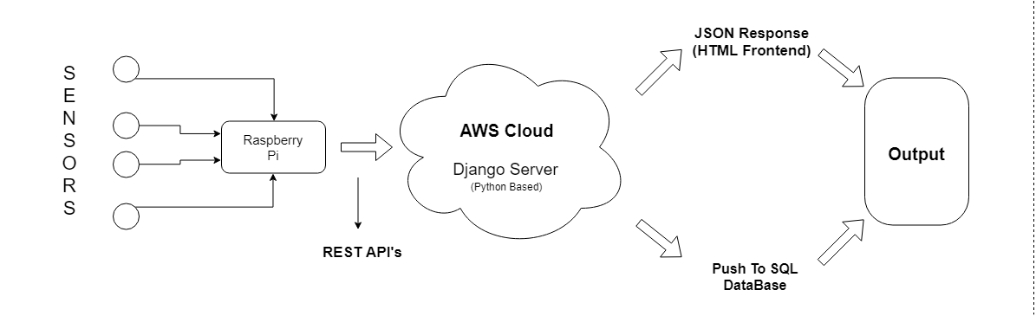
METHODOLOGY
PROJECT INFRASTRUCTURE

Slide 13
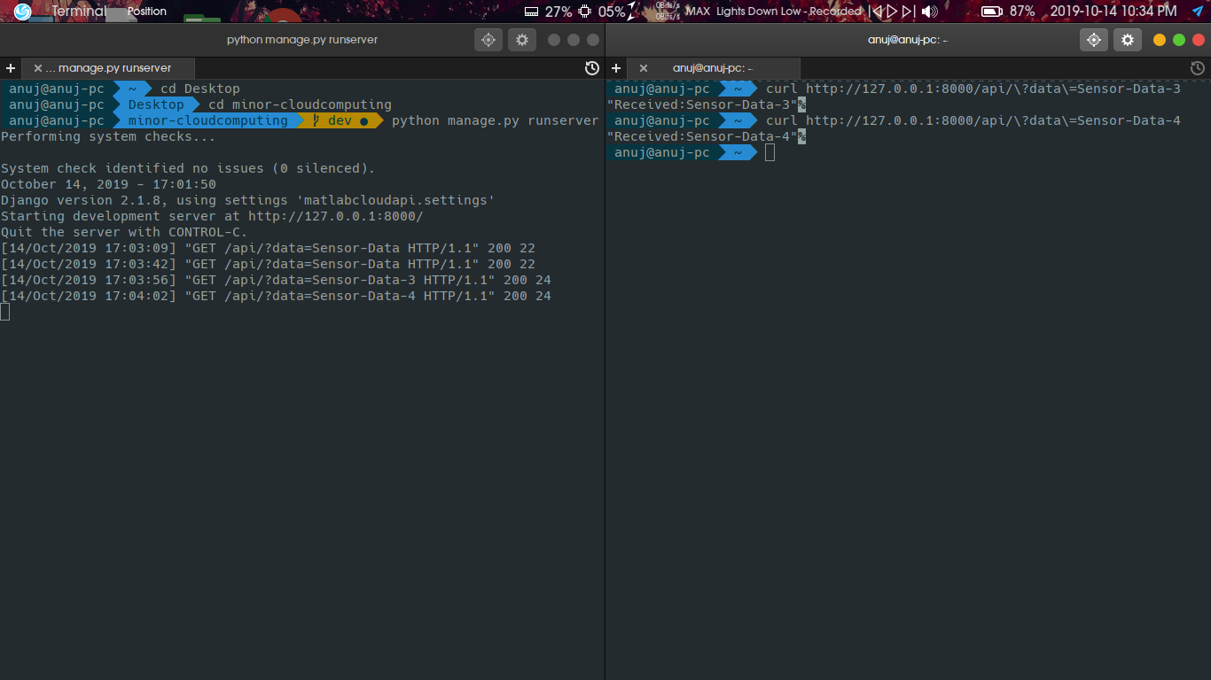
METHODOLOGY
API Response for Sensor-Data

Slide 14
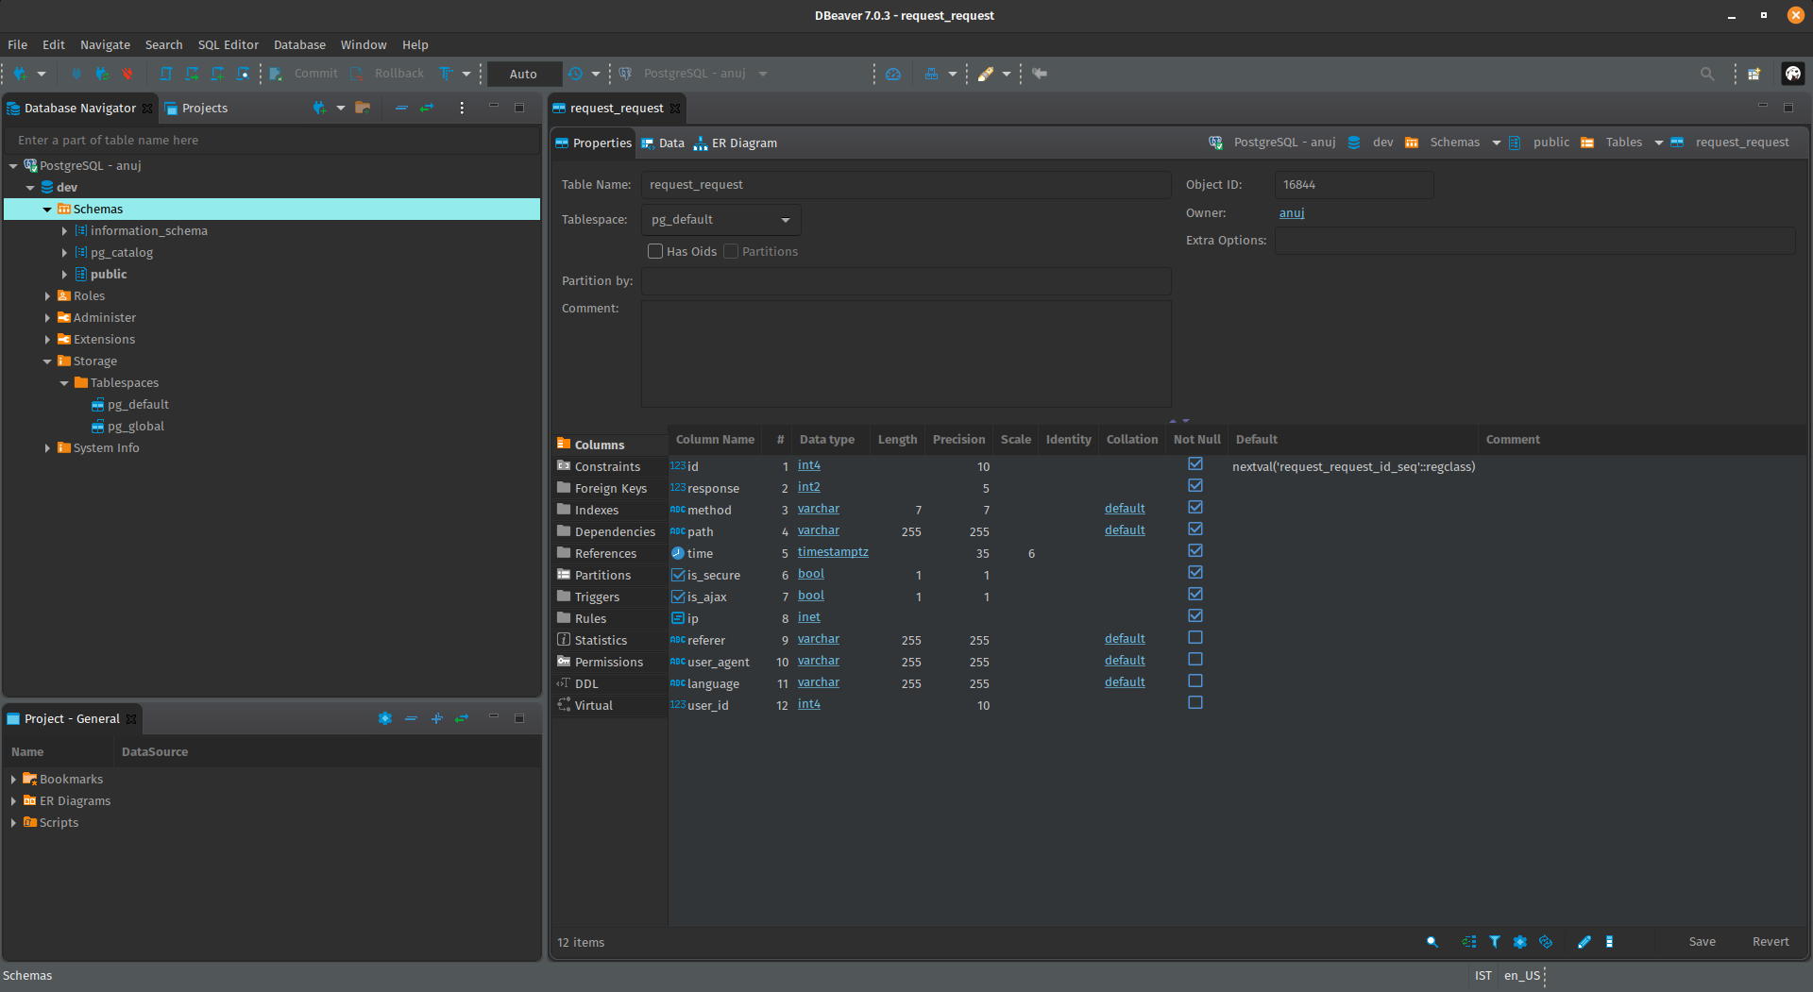
DATABASE(PSQL)

Slide 15
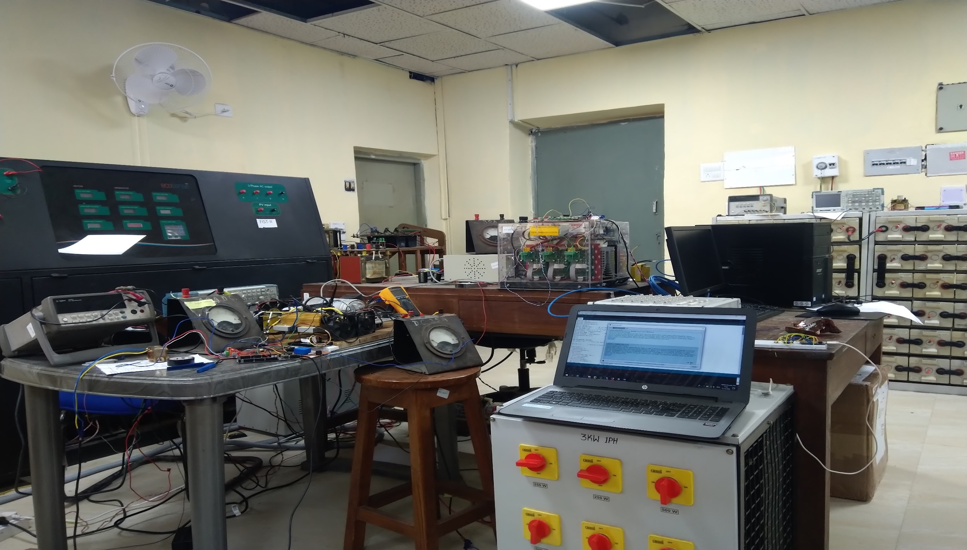
IOT SETUP WITH MICRO-GRID

Slide 16
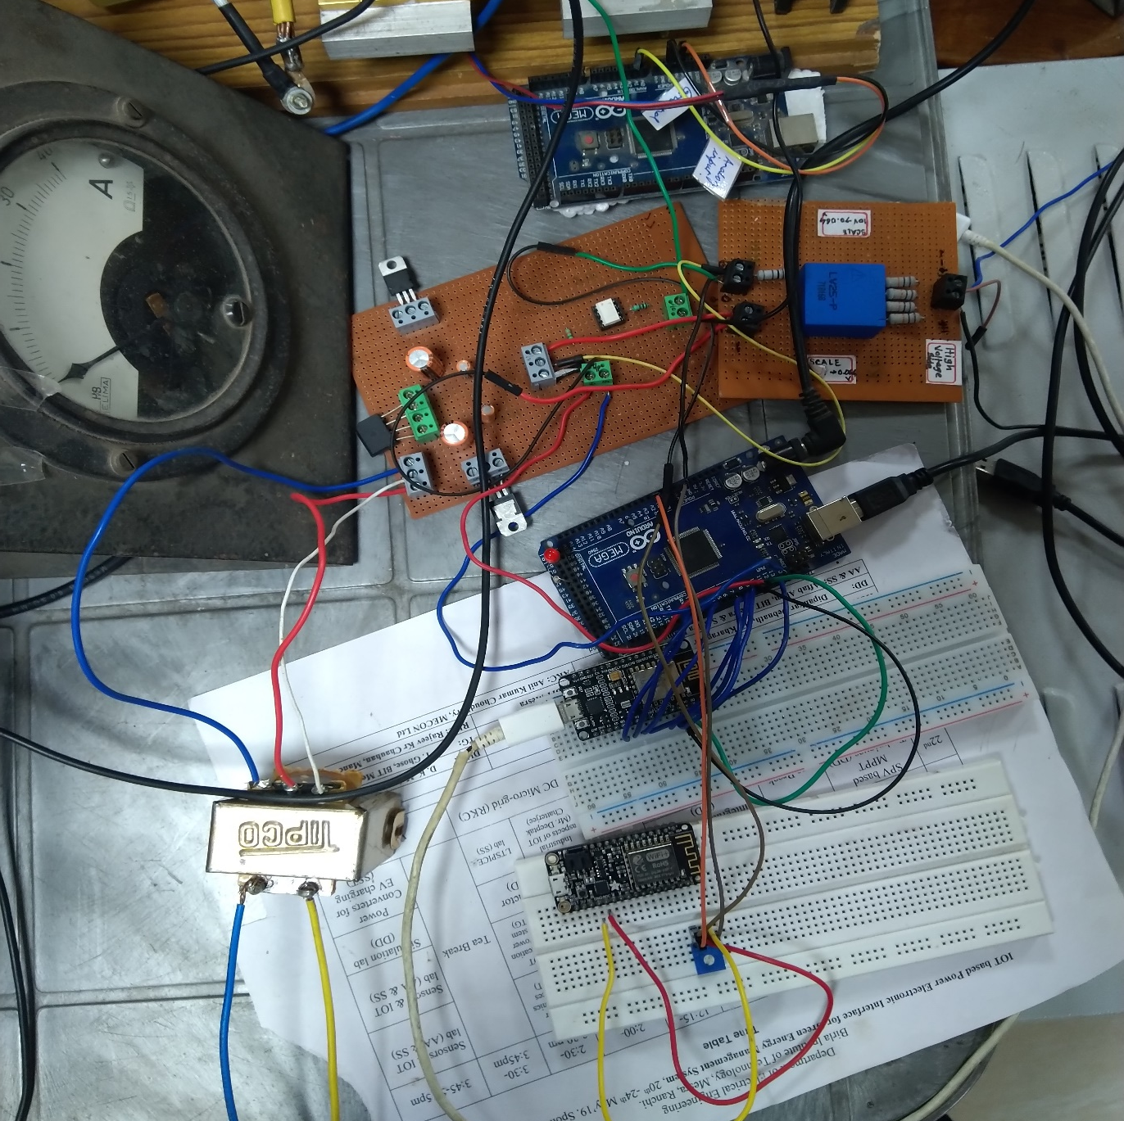
IOT SETUP

Slide 17
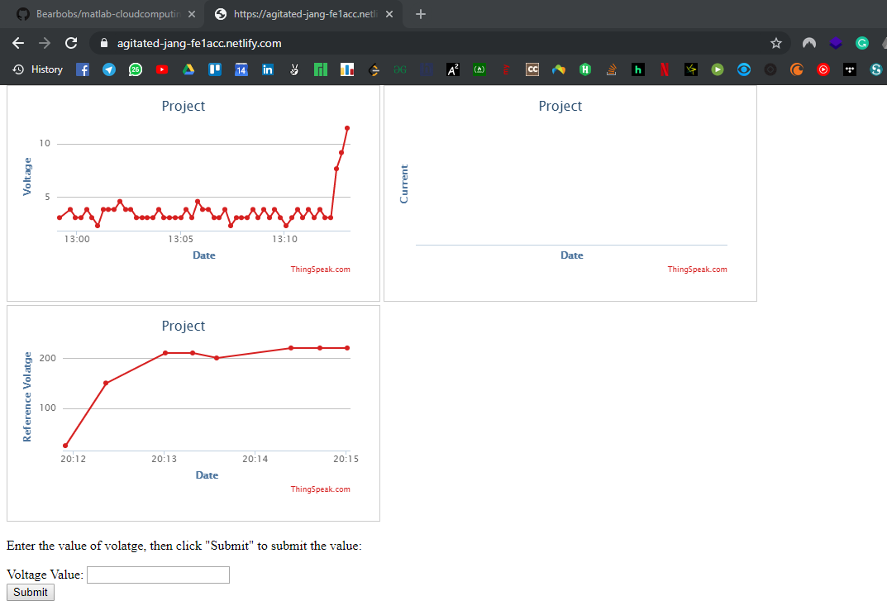
PREVIOUS DASHBOARD

Slide 18

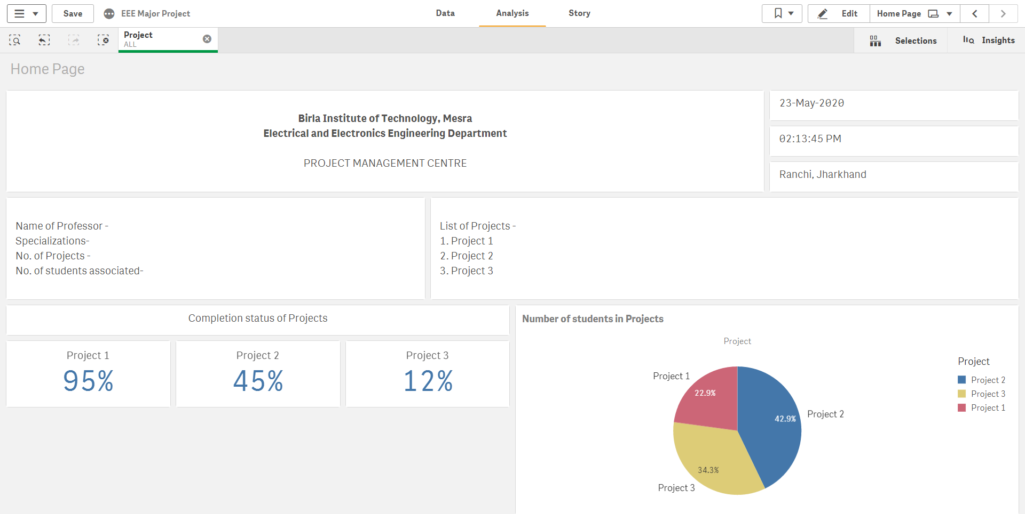
CLOUD MANAGEMENT DASHBOARD

Slide 19
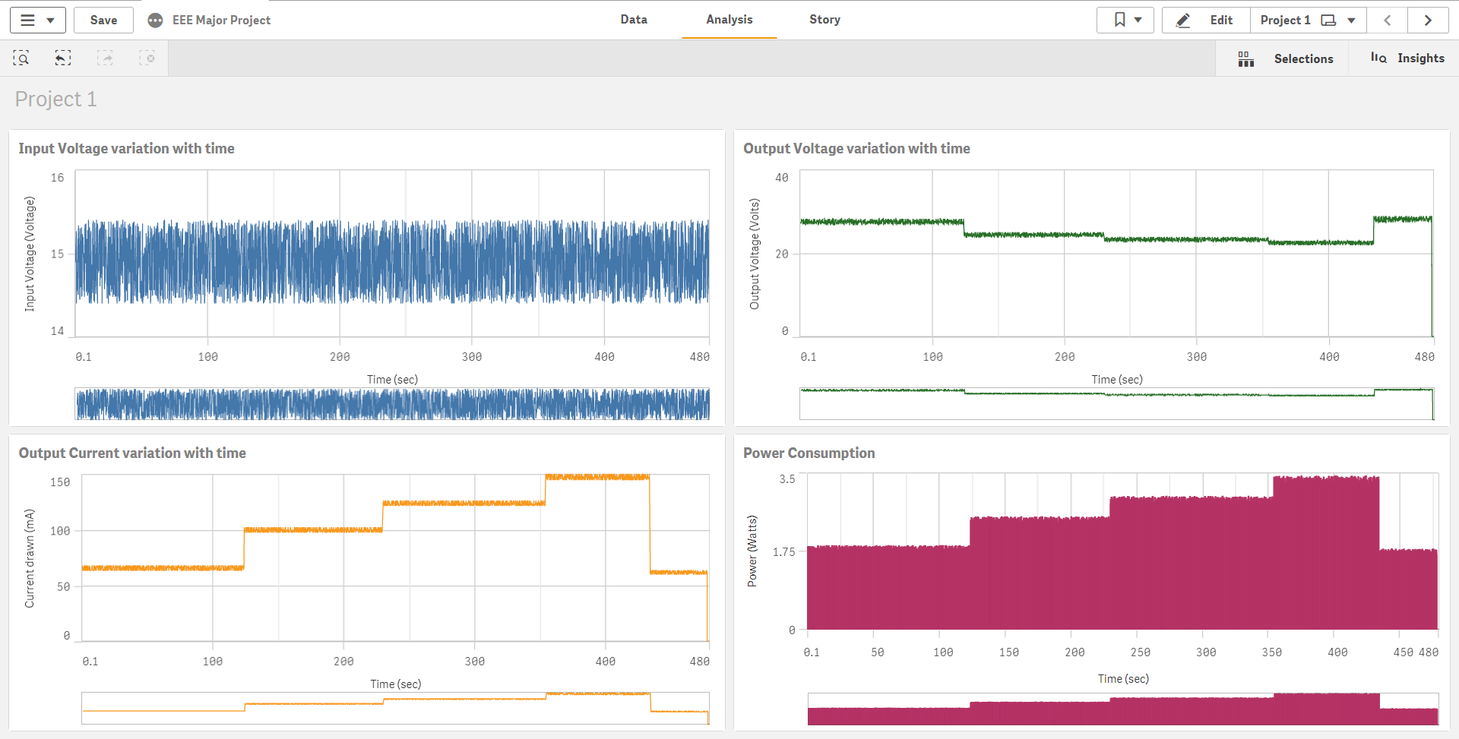
MONITORING PAGE ON DASHBOARD
ct Monitoring Page

Slide 20
BENEFITS TO COLLEGE
In-house built infrastructure which can be scaled according to need.
It will promote more collaborative projects among students of various expertise.
Small scale infrastructure like this is not commercially available and the large scale systems are not cost effective and usually industry-oriented.
The cost incurred in setup is minimal and maintenance cost is also low.
Easy to learn and multi-platform enabled.
Monitoring of project progress and status can also be implemented.

Slide 21
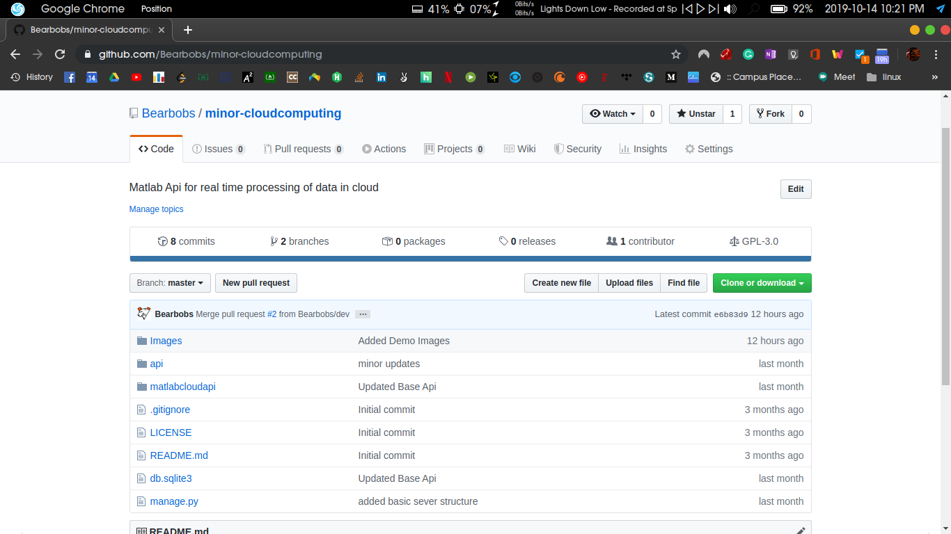
METHODOLOGY
Github Repository (https://github.com/Bearbobs/matlab-cloudcomputing)

Slide 22
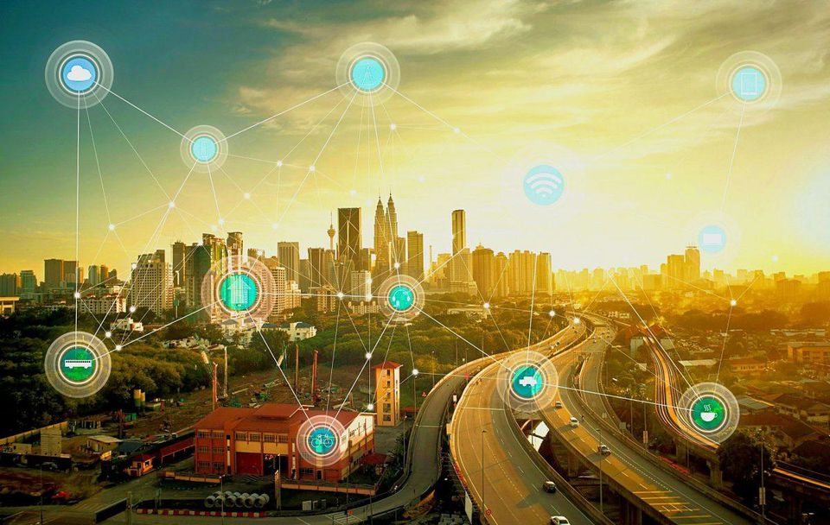

FUTURE SCOPE
The project combined with the micro-grid (consisting of solar, wind and battery) can become a product on its own and the computational infrastructure can be used to calculate the absorbed/injected power to find out the incentive.
The monitoring of any electrical power system becomes easy because the localization of problems and fault becomes easy due to multiple points of data acquisition.
Infrastructure bottleneck can be totally removed and that too with an economic benefit because even if a small space is available, IOT setup can be used and cloud computing removes the need for a local server.
Safety system become much more robust as the temperature monitoring (and various other systems) are used and the system can be shut down in parts and even the whole system can be shut down if temperature rise is severe.
Notes:
‹#›

Slide 23
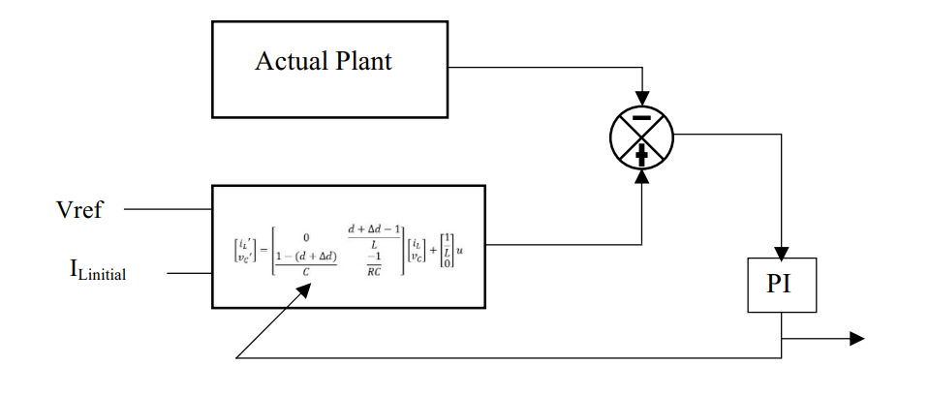
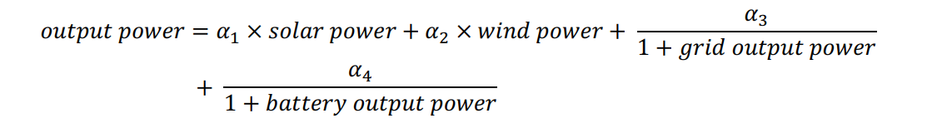
FUTURE SCOPE
State Estimation algorithm for reduction of current sensors required
Objective function for maximizing power from renewable power

Slide 24
LITERATURE REVIEW
Author/Date | Theoretical/conceptual framework | Conclusion
Chuang Deng, Junyong Liu, Yang Liu, Zhen Yu, 2016 12th International Conference on Natural Computation, Fuzzy Systems and Knowledge Discovery (ICNC-FSKD), IEEE, 13-15 Aug. 2016 | Cloud Computing based High-performance Platform in Enabling Scalable Services in Power System | This paper discusses the characteristics of the cloud computing techniques and further compares the features of the cloud computing to those of the traditional distributed computing. The paper also studies the types and forms of the modern services and requirements in power systems, and therefore aiming at designing and constructing a high-performance platform in enabling scalable power system services based on cloud computing is presented.
Yang Dongxu , Wei Hua, Wei Hongbo, 2010 International Conference on Power System Technology, IEEE, 24-28 Oct. 2010 | Architecture Design of Power System Fault Calculation Based on Cloud Computing Technology | This paper presents an architecture of power system fault calculation based on cloud computing technology to solve the problems of the current fault calculation system, which is caused by the insufficient calculation ability. The existing fault calculation system can not meet the requirements of the calculating efficiency and accuracy with the expansion of power system
Qiuhua Huang, Mike Zhou, Yao Zhang, Zhigang Wu, 2010 International Conference on Power System Technology, IEEE, 24-28 Oct. 2010 | Utilization of cloud computing for power system analysis | Cloud computing, characterizing scalability and pay-as-you-go model based service, provides a cost-efficient and flexible way to use large scale computing resources. In this paper, the motivation behind this trend is discussed and a short introduction of Cloud Computing is given.

Slide 25
REFERENCES
Cloud Computing based High-performance Platform in Enabling Scalable Services in Power System, Chuang Deng, Junyong Liu, Yang Liu, Zhen Yu, 2016 12th International Conference on Natural Computation, Fuzzy Systems and Knowledge Discovery (ICNC-FSKD), IEEE, 13-15 Aug. 2016
Architecture Design of Power System Fault Calculation Based on Cloud Computing Technology, Yang Dongxu , Wei Hua, Wei Hongbo, 2010 International Conference on Power System Technology, IEEE, 24-28 Oct. 2010.
Utilization of cloud computing for power system analysis, Qiuhua Huang, Mike Zhou, Yao Zhang, Zhigang Wu, 2010 International Conference on Power System Technology, IEEE, 24-28 Oct. 2010
W. Zhang, Z. Liu, M. Wang and X. Yang, "Research status and development trend of smart grid", Power System Technology, Vol.33(13), pp.
I. Foste， Y. Zhao， I. Raicu, "Cloud computing and grid computing 360 degree compared". Proceedings of Grid Computing Environments. Workshop， November 12-16，2008 Austin， TX， USA ： l-10
J. W. Rittinghouse, J. F. Ransome, "Cloud computing: implementation, management, and security". Boca Raton, FL, USA: CRC Press, 2010.
L. M. Vaquero, L. Rodero-Merino, J. Caceres, "A break in the clouds : towards a cloud definition", ACM SIGCOMM Computer Communication Review, 2009, 39(1):50-55
J. Geelan, Twenty one experts define cloud computing, virtualization[J/OL, http://virtualization.sys-con.corn /node/612375.
K. Chen, W. Zheng, "Cloud computing: system instances and current research", Journal of Software, Vol. 20(5): 1337-1348,.2009
M. D. Dikaiakos, D. Katsaros, P. Mehra, "Cloud computing: distributed internet computing for IT and scientific research", IEEE Internet Computing, Vol. 13(5): 10-13, 2009

Slide 26

Thank You !

